Slide 1
Chapter 10
Cell Growth and Division

Slide 2
10.1 Cell Growth
What would happen to a cell if it kept growing?
Cell divides instead
Two reasons
DNA would not be able to keep up with the needs of the cell
Surface area to volume ratio becomes inefficient

Slide 3
DNA Overload
DNA controls cells functions
As the cell becomes too big the DNA cannot keep up with all of the functions that the cell requires
Cell needs to make more DNA to keep up

Slide 4
Surface area to volume ratio
Cells exchange materials over a membrane, ex. water, nutrients, waste
Surface area of the cell controls the rate things go in and out.
Volume of the cell determines the amount of things that need to go in and out
The bigger the cell the more things that need to get in and out, but the volume grows faster than the surface area

Slide 5
Surface Area vs. Volume

Slide 6
Therefore a cell must divide
Cell division is the process by which a cell divides
One cell replicates its DNA and splits into two identical daughter cells

Slide 7
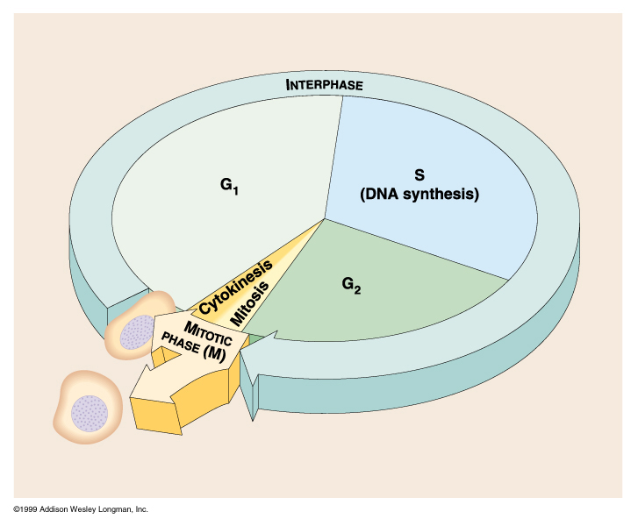
Cell Cycle

Slide 8
Interphase
Most of the time the cell is in interphase
Interphase consists of three stages
G₁ phase
S phase
G₂ phase

Slide 9
G₁ phase cells grow
new organelles are made to meet the needs of the growing cell

Slide 10
S phase
DNA is replicated
DNA is stored in structures called Chromosomes
Chromosomes are usually only visible during cell division, but they replicate before that.

Slide 11
Chromosomes
Each Chromosome consists of two sister chromatids
Connected at Centromere
When the cell divides each daughter cell gets one of the chromatids

Slide 12
G₂ phase
Shortest part of Interphase
In this phase the cell prepares for mitosis
Certain organelles are produced that the cell needs in mitosis

Slide 13
M phase
After interphase the cell starts the m phase
This phase has two parts
Mitosis
Cytokinesis

Slide 14
Mitosis
There are four stages to mitosis
Prophase
Metaphase
Anaphase
Telophase

Slide 15
Mitosis
Schematically: for diploid mothercells (for example somatic cells of human)

Slide 16
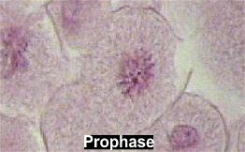
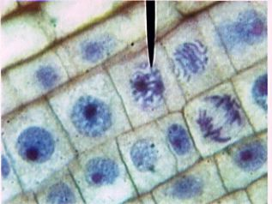
Prophase
Longest phase of mitosis
Chromosomes become visible
Centrioles separate to the ends of the cell and a spindle forms
Chromosomes attach to the spindle at the centromere
Nucleolus dissapears and nuclear envelope breaks down

Slide 17
PROPHASE

Slide 18
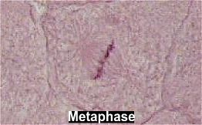
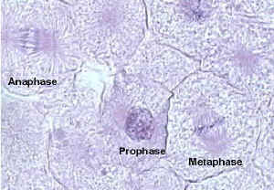
Metaphase
Usually very short
Chromosomes line up at the center of the cell
Microtubules connect centromere to the spindle

Slide 19
Metaphase

Slide 20
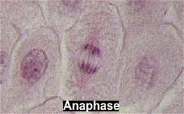
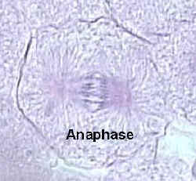
Anaphase
Centromeres separate
Chromatids separate and begin to move toward poles, they do not stop until they are in two groups, one at each pole

Slide 21
ANAPHASE

Slide 22
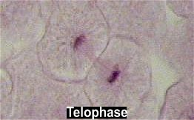
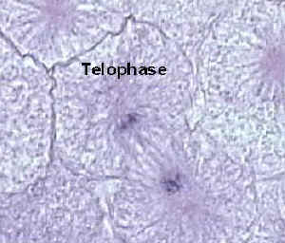
Telophase
Chromosomes begin to unravel and become less distinct
Nuclear envelope reforms and a nucleolus is visible again
Spindle breaks apart

Slide 23
TELOPHASE

Slide 24
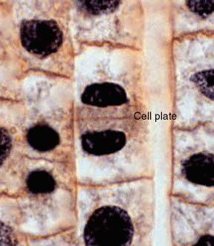
Cytokinesis
Cytokinesis is division of the cytoplasm
In animals the cell membrane pinches together
In plant cells a cell plate forms starting at the center and extending toward the edges of the cell.

Slide 25
Regulating the cell cycle
Cells divide at different rates
Some cells never divide, neurons
Some cells divide regularly
In the 80’s scientists discovered a protein called cyclin that seems to regulate cell growth
Cyclins regulate the timing of the cell cycle in eukaryotic cells

Slide 26
Cell Cycle Regulators
For years scientists tried to figure out what regulated this process
In 80’s a protein was discovered that appeared to do that
Cyclins regulate the timing of the cell cycle
Since this discovery, several more regulators have been found.
Scientists classify them as two types

Slide 27
Internal regulators
Proteins that use things inside the cell to decide when it is time to divide
Some watch things like chromosome duplication and make sure it is finished before the cell divides

Slide 28
External Regulators
Respond to occurrences outside of the cell
Cause the cell to speed up or slow down cell division
Growth, mending wounds
Nearby cells or molecules can inhibit excessive growth
Pg. 250 petri dish example

Slide 29
Cancer
Cancer is the inability to control cell division
Cells continue to divide and usually damage cells around them
Several reasons exist for the different types of cancer both external and internal

Slide 30
Stem cells
Read pg. 253
Class discussion

Slide 31
Meiosis
Meiosis is the process of reduction division in which the number of chromosomes per cell is cut in half and homologous chromosomes that exist in a diploid cell are separated.
Basically, it is mitosis that happens two times to make 4 daughter cells with a haploid chromosome number.
Diploid cells have two sets of chromosomes
Haploid cells have one set of chromosomes

Slide 32
Meiosis has two stages
Meiosis I
Meiosis II

Slide 33
Meiosis I
Before this stage each chromosome is replicated
Each chromosome finds its homologous pair forming a tetrad
Within the tetrad portions of homologous chromatids may be switched around
This is called crossing over and forms new allele combinations

Slide 34
The homologous chromosomes randomly separate to each pole forming two diploid cells that are different from each other and different from the parent cell

Slide 35
Meiosis II
These two daughter cells go through another cell division without replication of its DNA
Chromatids split and go to the separate poles
This results in 4 haploid cells each different from each other and different from the parent cell
These cells are called gametes

Slide 36
In males the gamete is called a sperm and each of the four cells makes one
In females one of the four cells usually gets most of the cytoplasm, making it the egg and the other three are called polar bodies

Slide 37
Mitosis vs. Meiosis
Cycles appear similar, but they are very different
Mitosis makes two identical diploid cells that are identical to the parent
Different types of cells undergo Mitosis
Two cycles that are very similar
Meiosis makes four haploid cells from one diploid cell, all four are genetically different
Only sex cells undergo Meiosis

Slide 38
MEIOSIS

