Slide 1
CHAPTER 35
The Nervous System

Slide 2
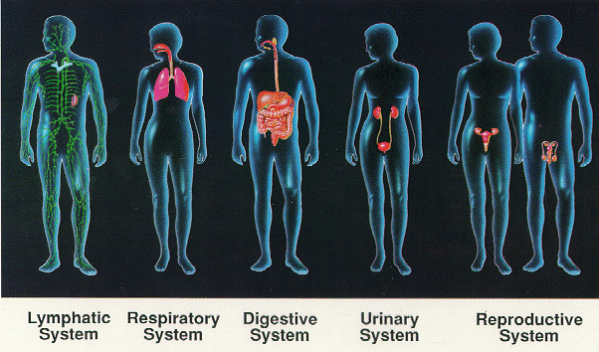
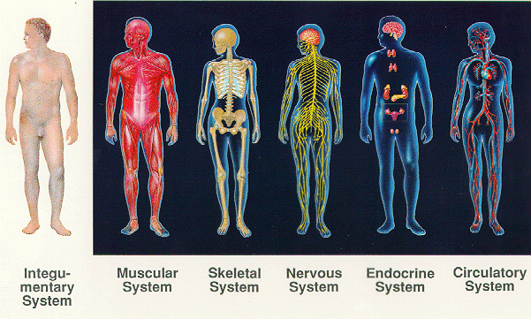

Slide 3
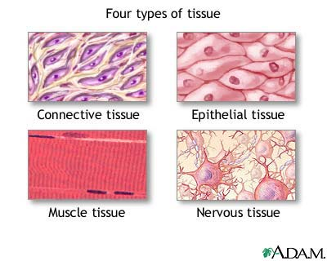

Slide 4
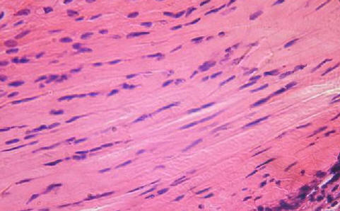
Connective Tissue
Holds organs in place
Binds parts of the body together
Pads and insulates the body
Examples:
Tendons
Bloods
Cartilage
Adipose Tissue

Slide 5
Epithelial Tissue
Covers the surface of the body
Lines internal organs
Functions include secretion, protection,
absorption, and detection of sensation
Examples:
Glands: Secretes saliva, sweat, milk, etc.
Skin
Lining of the heart

Slide 6
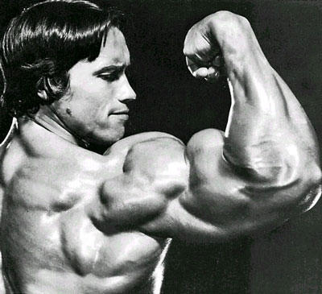
Muscle Tissue
Most abundant
Controls internal movement
Blood flow, digestion
Controls external movement
Physical movement
Examples:
Cardiac
Skeletal
Smooth

Slide 7
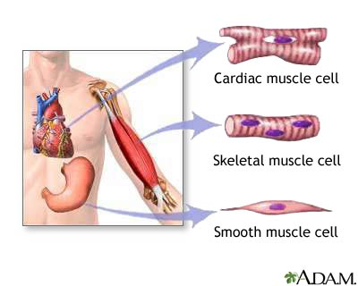

Slide 8
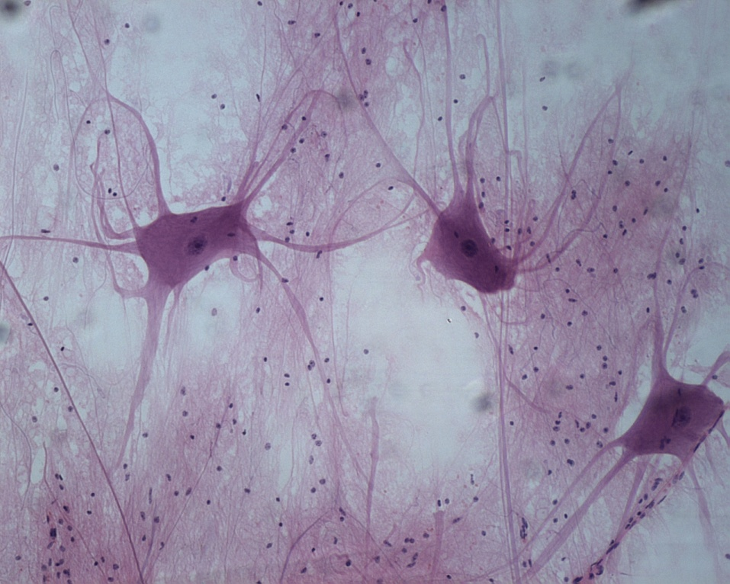
Nervous Tissue
Receives messages from internal and
External sources
Interprets the data received
Directs the response

Slide 9
Homeostasis
The dynamic state of equilibrium, the maintenance
of a stable, internal condition within narrow limits
(pH & body temp)
Feedback Inhibition –
The product of a system shuts down or limits its operation (furnace)
Positive Vs. Negative Feedback
Homeostasis (3:05)

Slide 10
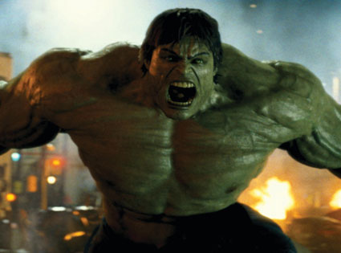
Positive Feedback
Action intensifies a condition so it is driven beyond normal limits
Blood clotting/scabs
Labor contractions
Fever
Hulk Smash

Slide 11
Negative Feedback
A receptor sense change in condition beyond specific limits, activates effector to correct, when it is correct, shuts down effector.
Thermoregulation
Shivering
Sweating
Blood pressure
Vasodilation/constriction
Feedback Analogy vid.(3:07)
Thermoregulation &
Vasoconstriction vid (:30-4:10)

Slide 12
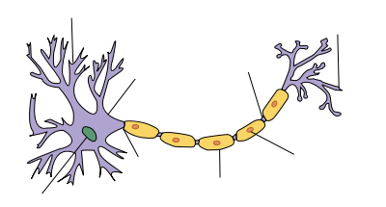
Neuron
Basic structural unit of the nervous system
Function: To transmit impulses throughout
the body

Slide 13
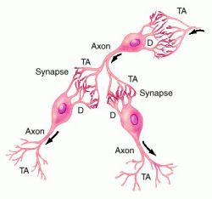
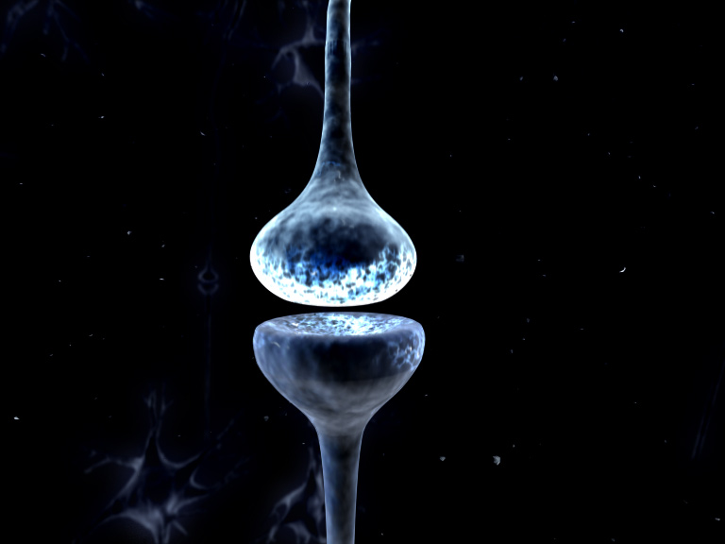
Synapse
A gap that separates adjacent neurons
One cell’s axon terminals butt up against
another cell’s dendrites

Slide 14
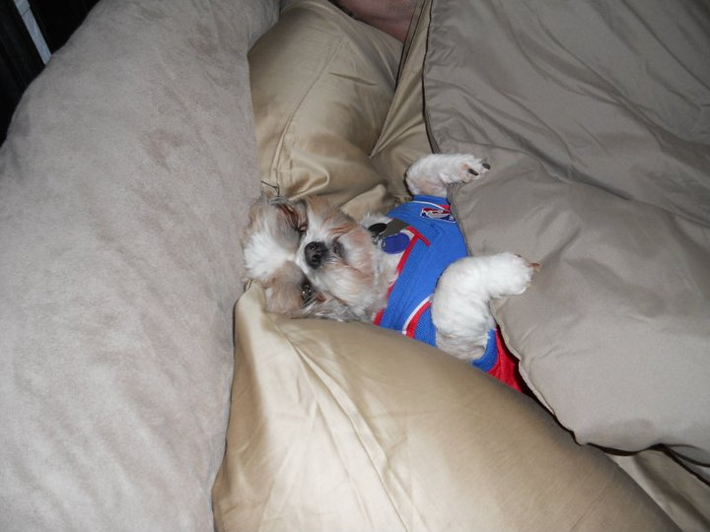
Nerve Impulse
An electrical signal due to chemical changes
along the membrane of a neuron
Begins with cell at rest. This is called resting
potential
at resting potential, Na is outside
the cell, and K inside

Slide 15
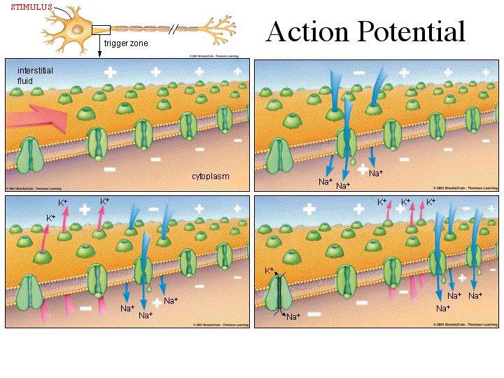

Slide 16
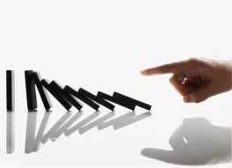
English Please?
Receptor cells receive a stimulus,
and then send a signal down the neuron. This signal is sent the length of the axon via a wave of chemical & electrical change, like dominoes.

Slide 17
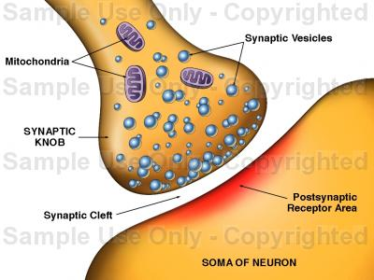
Neurotransmitter –
Chemicals used to transmit the impulse across a synapse to another cell
Synaptic Vesicle –
Contains neurotransmitters in axon terminal

Slide 18
The Process:
Action Potential reaches axon terminal (Presynaptic)
Synaptic vesicles release neurotransmitters
Neurotransmitters cross synaptic cleft and bind to postsynaptic receptors
Threshold – minimum level of stimulus to activate a neuron. All or nothing response.
Survivor vid.
Adjacent dendrite is depolarized
Action potential continues on.

Slide 19
Central Nervous System
Made up of the brain and the spinal cord
Relays messages, processes information, analyses information
Protected by skull and spinal column

Slide 20
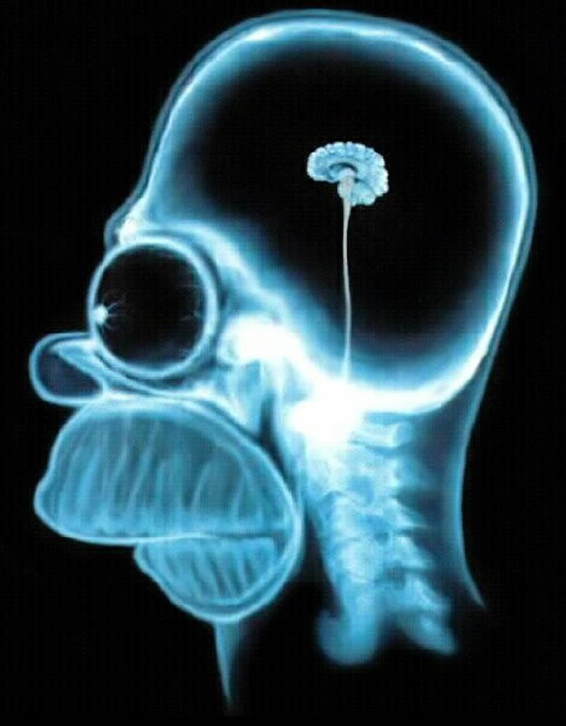
The Brain
Control center for the body
Composed of mainly interneurons
(approx. 100 billion)

Slide 21
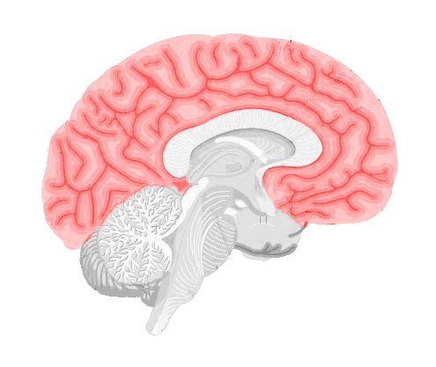
Cerebrum
Largest part of brain. Folds and grooves increase surface area.
Responsible for conscious or voluntary activities.
Two hemispheres,
Connected by corpus
Collosum.
Switching station.
Right – creativity,
Artistic ability
Left – Logic, Math
Analytical ability

Slide 22
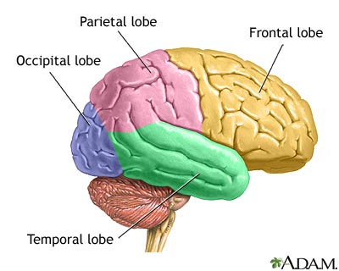
Cerebrum
Divided into 4 lobes based on parts of skull that protect them.

Slide 23
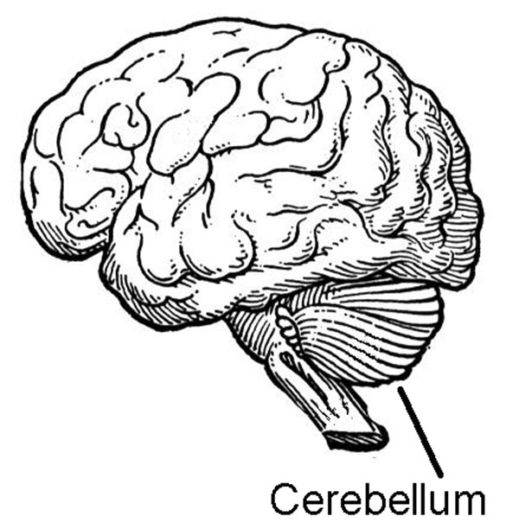
Cerebellum
Back of the skull
Coordinates and balances action of muscles

Slide 24
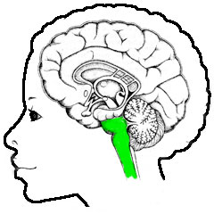
Brain Stem
Below cerebellum
connects brain to spinal cord
Two regions: Pons and Medulla Oblongata
Controls involuntary functions: Heart rate, blood pressure, breathing, swallowing

Slide 25
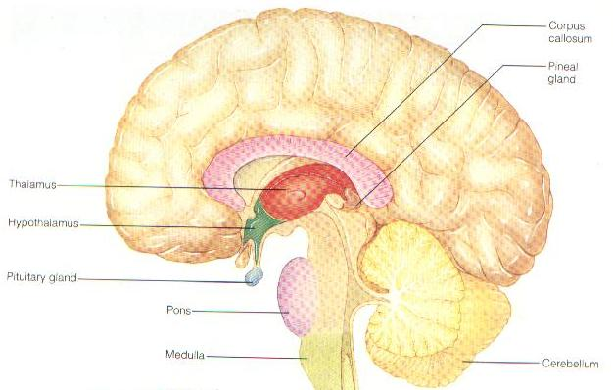
Hypothalamus
Control center for recognizing and analyzing hunger
Thirst
Fatigue
Anger
Body temperature

Slide 26
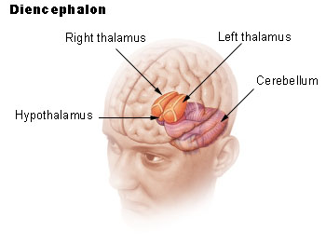
Thalamus
Receives information from sense organs and relays them to proper region of cortex for processing

Slide 27
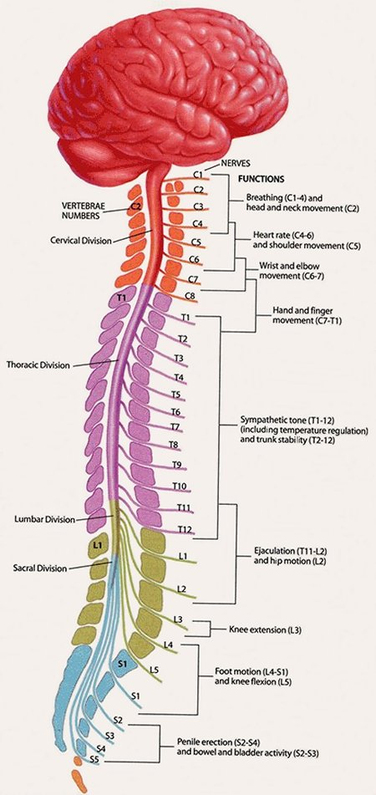
Spinal Cord
Protected by vertebrae
Function: Relay Station
There are 31 pairs of spinal nerves that connect the brain with the body
Reflex:
An automatic response to stimuli.
Reflexes are carried out by spinal cord. It skips the brain step, and makes an automatic decision.

Slide 28
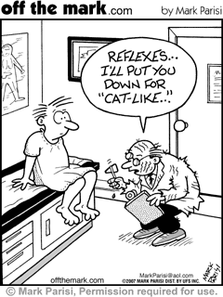

Slide 29
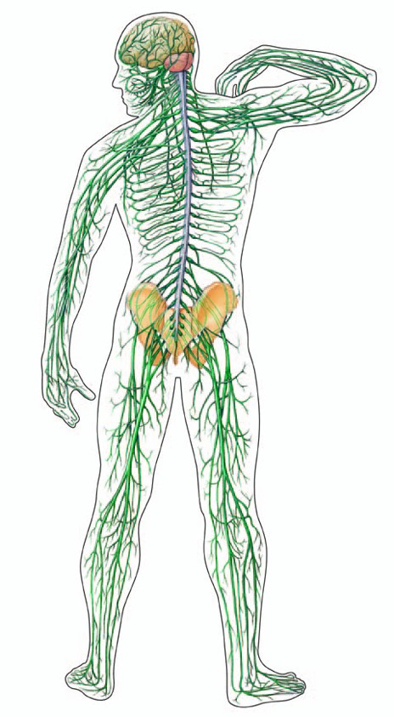
Peripheral Nervous System
The PNS consists of all the nerves and associated cells outside the brain and spinal cord.

Slide 30
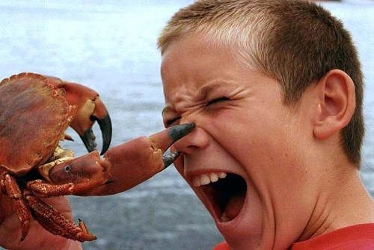
Peripheral Nervous System
Sensory neurons:
Transmit impulses towards CNS
Motor neurons:
Transmit impulses from CNS to effectors (muscles and glands)

Slide 31
Peripheral Nervous System
Somatic
Vs.
Autonomic

Slide 32
Somatic Nervous System
Voluntary motion
Directs voluntary contraction of skeletal muscle
Reflexes – An instantaneous response to stimulus
Reflex Arc
Sensory Neuron ->
Interneuron (spinal cord) ->
Motor Neuron
Marv Video Reflex Video

Slide 33
Autonomic Nervous System
Involuntary
Controls the activities of the automatic, or involuntary muscles and organs
Fight or Flight
Sympathetic Vs. Parasympathetic

Slide 34
Sympathetic
Fight or flight scenario
Prepares body for action
Increased heart rate
Release sugar from liver
Increased breathing
Faster reaction time
Alert level on high

Slide 35
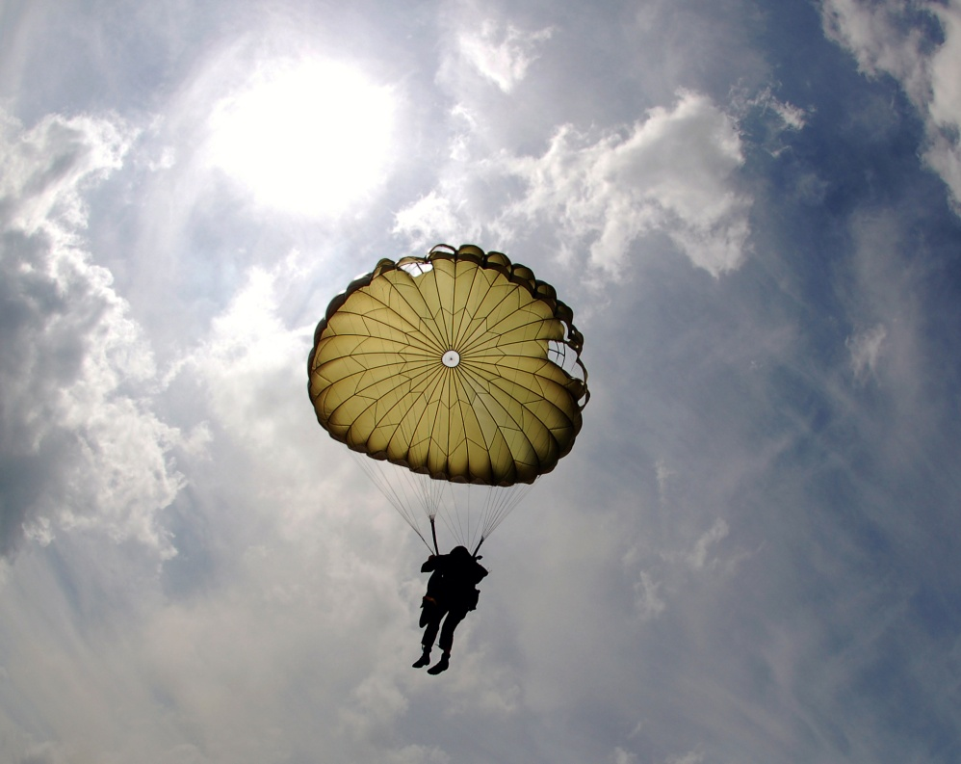
Parasympathetic
Activates tranquil functions
decreases heart rate
Breathing slows
Like a parachute

Slide 36
The Senses
Sensory Receptors: Neurons that react directly to stimuli from the environment.
5 Types:
Pain
Thermo
Mechanorceptors
Chemoreceptors
Photoreceptors

Slide 37
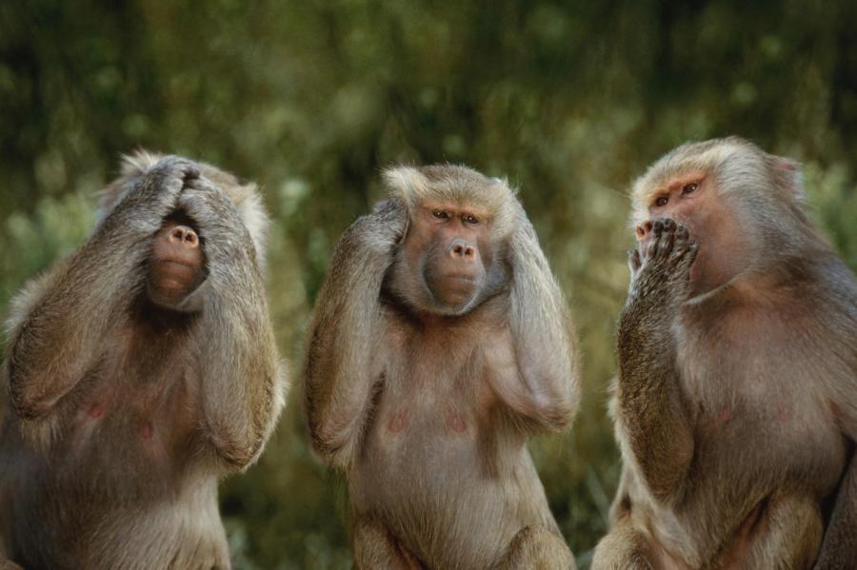
The Senses
Vision
Hearing
Smell
Taste
Touch

Slide 38
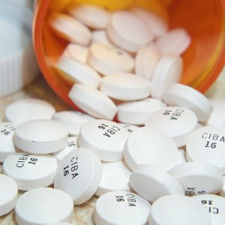
Drugs
Any substance that changes structure or function of the body.
Many drugs affect the synapse

Slide 39
Drugs
Stimulants: increase the release of neurotransmitters
Addictive
Caffeine
Nicotine
Methamphetamine
Cocaine
Ecstacy

Slide 40
Drugs
Depressants: Interferes with action potentials
Slows Nervous System down
Addictive
Alcohol
Marijuana
Opiates
Heroin
Opiates: Stimulate the release of specific neurotransmitters that block pain receptors.

Slide 41
Mouse Party

