Slide 1
Introduction to Evolution

Slide 2
After watching this video, you will need to be able to:
1. Know and explain, using examples, the definition of evolution.*
2. Why things change over time. **
Notes:
Evolution is any change in heritable traits within a population across generations.
** organisms change over time because of genetic variation with in a species.

Slide 3
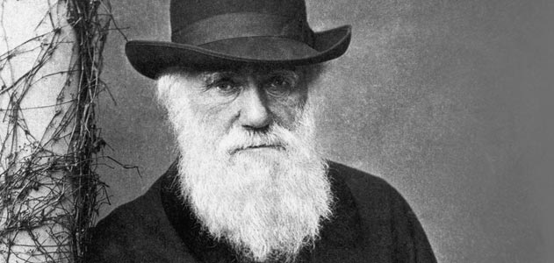
https://www.youtube.com/watch?v=GhHOjC4oxh8

Slide 4
So,
Be able to summarize human evolution in two sentences or less after watching the clip below.*
https://www.youtube.com/watch?v=ROwKq3kxPEA
Notes:
* Human evolution is a many branched process and is based on natural selection.

Slide 5
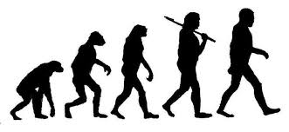
After watching the video below, you will know what evolution
IS Not!*
https://www.youtube.com/watch?v=xpo8SdY1JSw
Notes:
* Evolution is not ones species turning into another.

