Slide 1
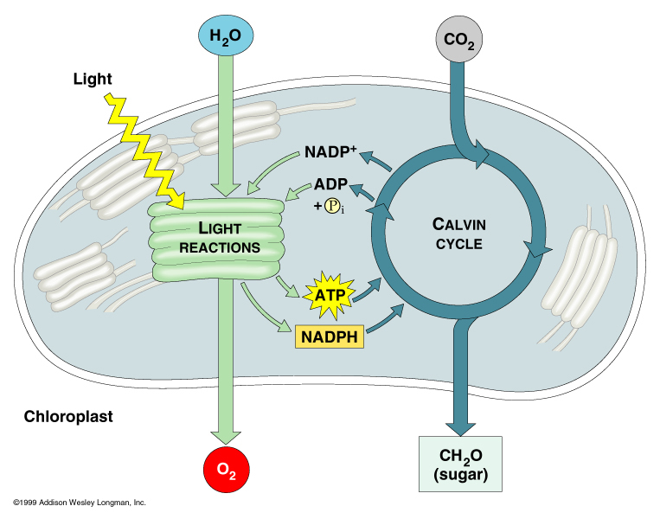
Photosynthesis & Respiration

Slide 2
Photosynthesis
Photo: the capturing and converting of E
Energy: the ability to do work
Photo: changing sunlight into chemical E in carbohydrate bonds
Carbo bonds: sugars and starches

Slide 3
Historical Perspective
Van Helment: the mass of plants comes from H₂O
Priestly: used a vacuum to discover that plants produce O₂
Ingenhousz: exposure to light for plants to produce O₂

Slide 4
Requirements for Photosynthesis
Basic Requirements:
Sunlight, Pigments, E Storing Compounds
Formula:
6CO₂ + 6H₂0 ^{LIGHT} C₆H₁₂0₆ + 6O₂

Slide 6
Sunlight
Autotrophs: all green plants, use sunlight directly to produce food from inorganic molecules in the environment
Heterotrophs: obtain E from food they eat. Eat Heteros, Autotrophs, or both

Slide 7
Pigments
Photo begins when light is absorbed by pigments
Pigments are colored substances that absorb or reflect light
chlorophyll absorbs red and blue light

Slide 8
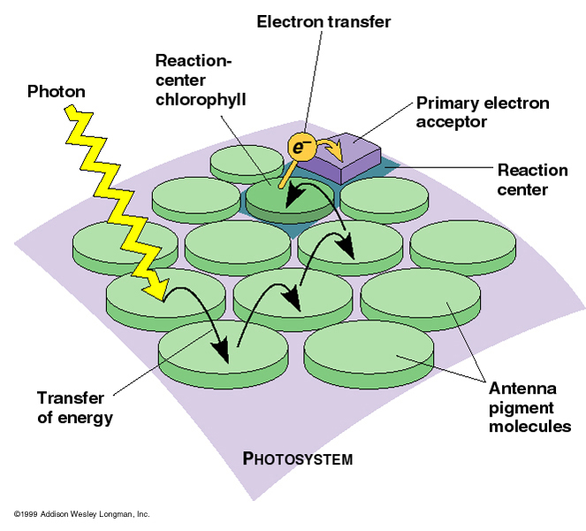

Slide 9
E absorbing compounds
E is transferred to electrons (e-) in matter (chemical bonds)
An electron carrier can accept high E e-’s, and transfer them to another compound
In Green Plant cells: e- to higher E level in chlorophyll, trapped in two bonds

Slide 10
NADP: add two e-, get NADPH
Nicatiamide Adenine Dinucleotide
ATP: Adenosine Triphosphate
consists: adenine, Ribose, Phophate (PO₄)

Slide 11
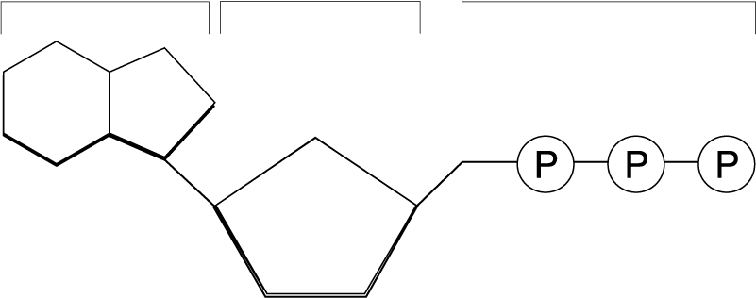
The ATP Moleucle
Adenine
3 Phosphate groups
Ribose

Slide 12
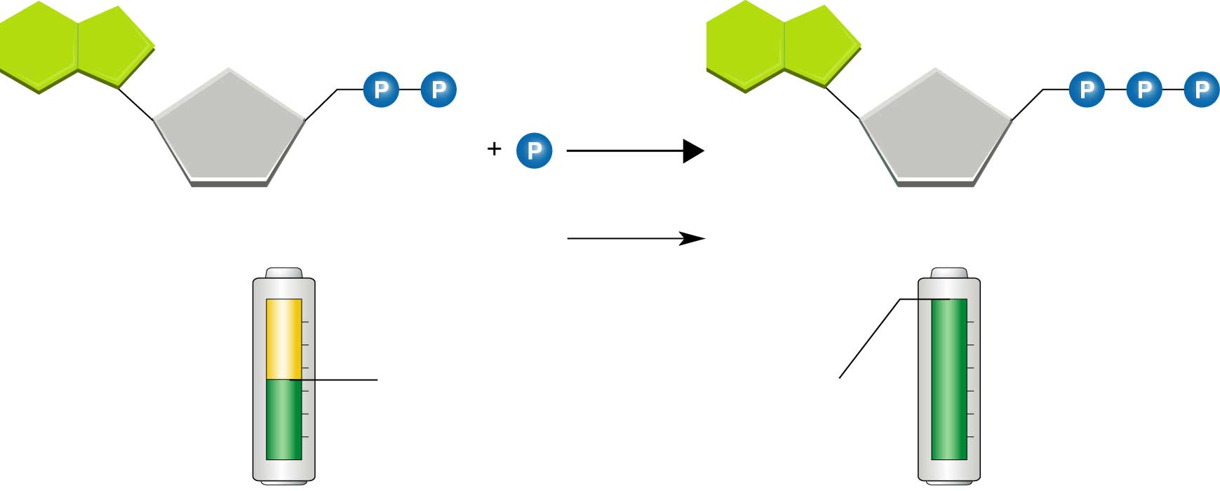
ADP
ATP
E

Slide 13
Light Dependant and independent Reactions
Basic: Light Dep, Energy of light is captured and used to make E storing compounds (ATP, NADPH)
Basic: Light Inde, Use E in NADPH & ATP to produce Glucose
Glucose is more stable then ATP & NADPH, holds 100x more E

Slide 14
Light Dependent Reaction
What we think of as Photosynthesis
Occurs in Chloroplasts Photosynthetic Membrane in clusters of pigments cells called a Photosystem
Photosystems: capture E in sunlight in Pigments such as chlorophyll
e- transport occurs in photosystems,

Slide 15
Are carriers for the Electron Transport Chain (ETC)
O₂ is produced from the broken H₂O in photosytem II.

Slide 16
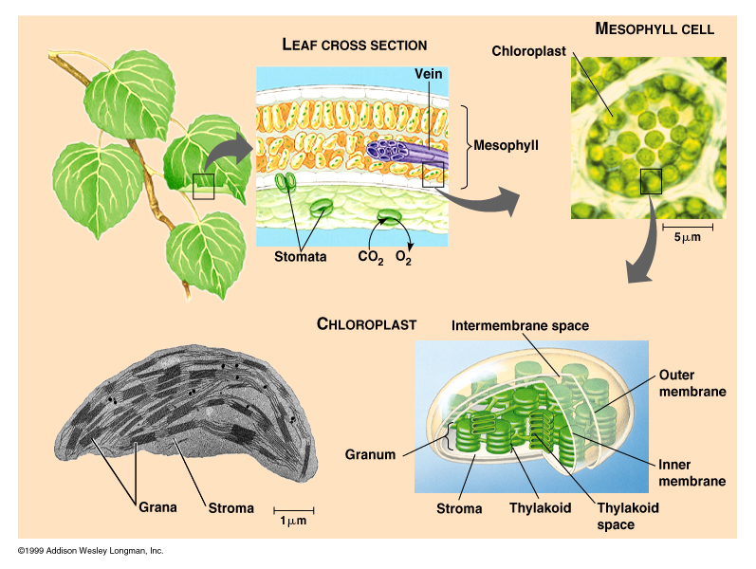

Slide 17
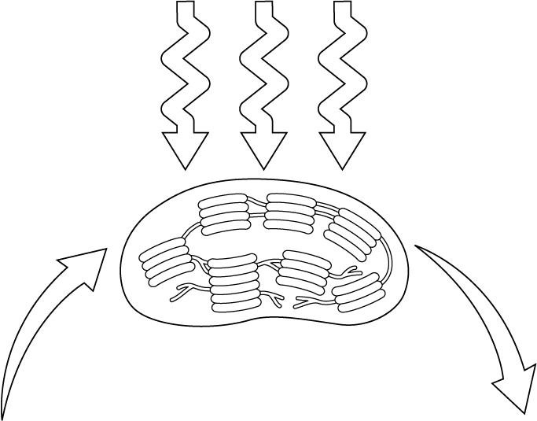
Light Energy
Chloroplast
CO₂ + H₂O
Sugars + O₂

Slide 18
Light Independent Cycle (Calvin)
Uses enzymes to speed the reaction to use CO₂, ATP, and NADPH to produce high E compounds that can be stored for a long time (Glucose)
Calvin cycle starts with CO2 /ATP and NADPH
Products= GLUCOSE/ADP/NADP

Slide 19
Light Independent Cycle (Calvin)
Reaction has to cycle twice to produce one 6 carbon glucose

Slide 20
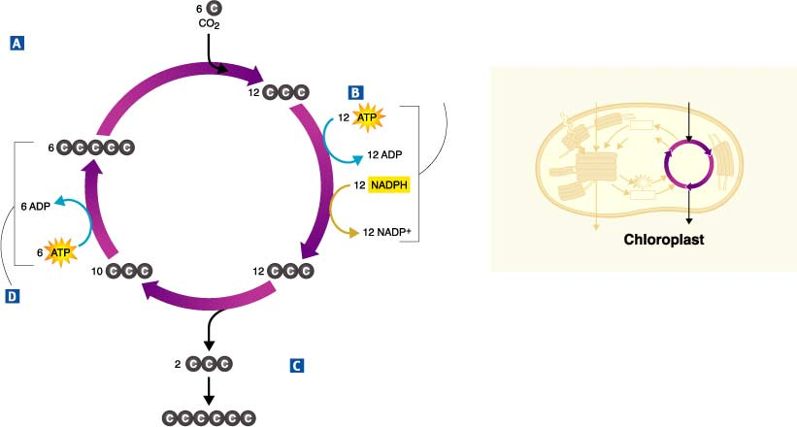
Figure 8-11 Calvin Cycle
The Calvin Cycle
Section 8-3
CO₂ Enters the Cycle
Energy Input
ChloropIast
5-Carbon
Molecules
Regenerated
6-Carbon Sugar
Produced
Sugars and other compounds
Go to Section:

Slide 22
Respiration
Basic formula
C₆H₁₂O₆ + 6O₂ 6CO₂ +6H₂0
Respiration: release E by breaking down food molecules in presence of O₂
Three Stages: Glycolysis, Krebs, and Electron Transport

Slide 23
Glycolysis
Glycolysis:Breaking down glucose in the cytoplasm of the cell.
Enzymes catalyse chemical reactions that change glucose, step by step into 2 Pyruvic Acids

Slide 24
Is an oxidation reaction, but does not need O₂ to react.
Has an E investment and E yielding phase

Slide 25
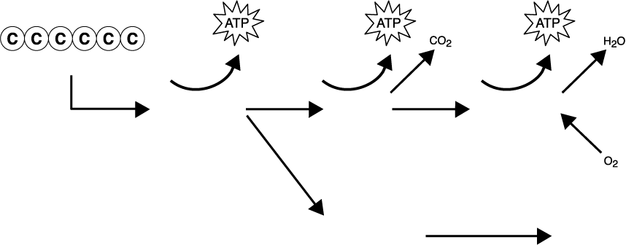
Section 9-1
Chemical Pathways
Glucose
Electron transport
Glycolysis
Krebs cycle
Fermentation (without oxygen)
Alcohol or lactic acid
Go to Section:

Slide 26
The Krebs Cycle
In the presence of O₂, pyruvic acid enters the mitochondria to begin the krebs cycle
Occurs in the mitochondrial matrix of the inner mitochondrial membrane

Slide 27
It takes two turns of the Krebs cycle to completely oxidize one glucose
Krebs cycle is also called the Citric Acid cycle

Slide 28
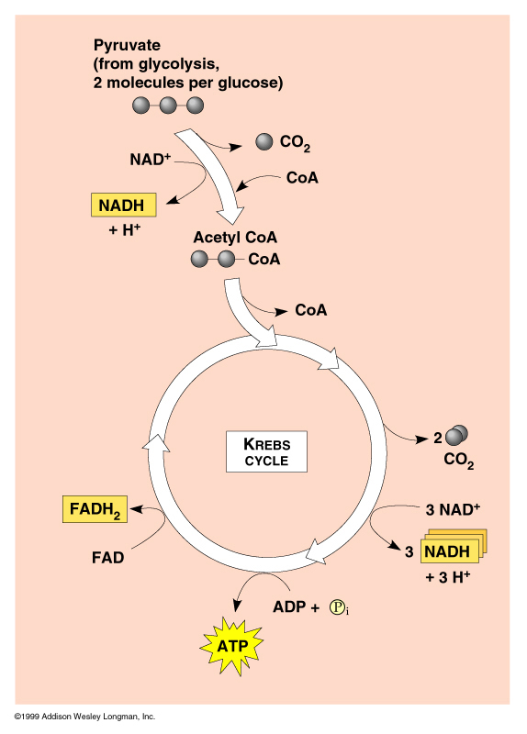

Slide 29
Electron Transport Chain
Occurs in the inner mitochondrial membrane
Uses high E e- (FADH & NADH) from Krebs to convert ADP to ATP
End with the final e- acceptor, the H₂O

Slide 30
Energy Totals….
Glycolysis: 2 ATP
Krebs and ETC: 34 ATP
Total: 36 ATP
Is only 38% of Total E in glucose
Rest is lost as heat

Slide 31
Fermentation
If O₂ is not present, the Pyruvic acid uses NAD to produce energy
Called Anaerobic Fermentation
Enables cells to produce ATP without the presence of O₂
Two basic types:

Slide 32
Lactic Acid Fermentation
When O₂ is scarce, human muscle switches from aerobic respiration to LAF. Lactate accumulates, but is eventually taken to the liver and converted back to pyruvic acid
Pyruvic Acid + NADH ➔ Lactic Acid +NAD

Slide 33
Alcoholic Fermentation
Occurs in yeasts and other microorganisms
Important to bakers and brewers because of CO₂ production
Alcohol is not desirable to yeast, will die at 12% alcohol.
Pyruvic Acid + NADH ➔ Alcohol +CO₂ + NAD

